Slide 1
Signals AND SYSTEMS
Final Presentation
Made By
Abhiroop Mukherjee : 510519109
Sayak Rana : 510519108
Hritick Sharma : 510519114

Slide 2

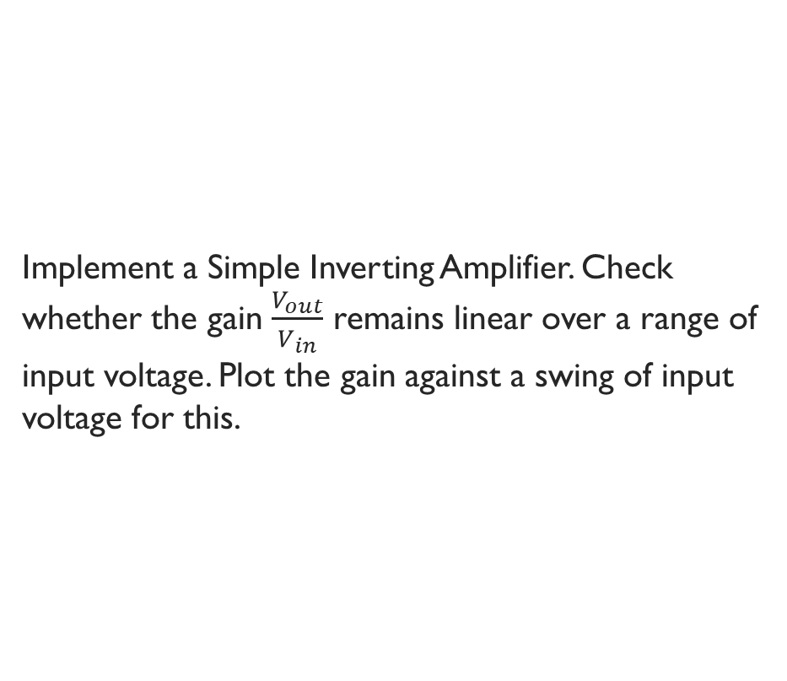
Question 1
Implement a Simple Inverting Amplifier. Check whether the gain $\frac{V_{out}}{V_{in}}$ remains linear over a range of input voltage. Plot the gain against a swing of input voltage for this.

Slide 3
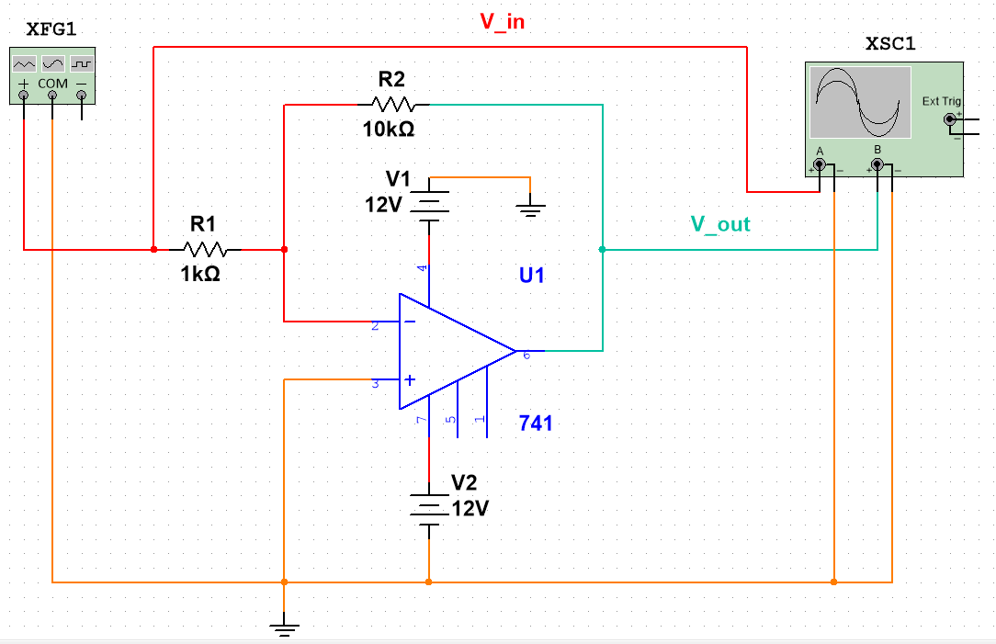
Circuit Diagram

Slide 4
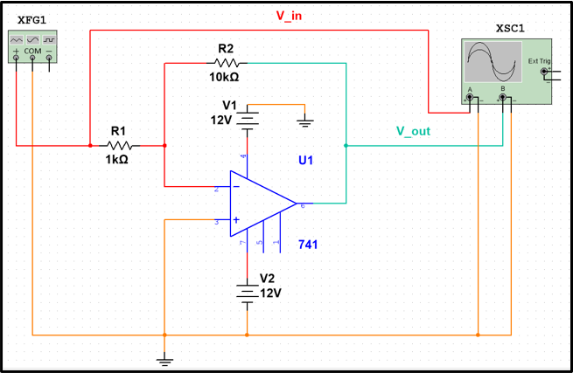





Circuit Analysis
$$i_{1}$$
As Gain is Amplifier is very Large
$V_{a}− V_{b}≈0$
$or V_{a}≈V_{b}≈0 (V_{a} Grounded)$
Using Kirchhoff's Current Law :
$\frac{0 −V_{in}}{R_{1}}+ \frac{0 − V_{out}}{R_{2}}=0$
$or V_{out}=−\frac{R_{2}}{R_{1}}.V_{in}$
$$i_{2}$$
$$V_{b}$$
$$V_{a}$$

Slide 5
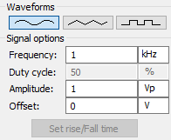
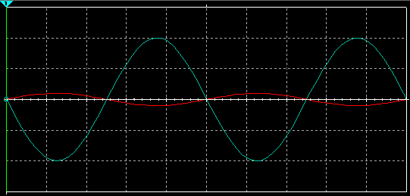



I/O Example $1$
Here Red Plot is $V_{in}$ and the Blue Plot is $V_{out}$
$R_{1}=1kΩ$
$R_{2}=10kΩ$
$V_{out}=−\frac{R_{2}}{R_{1}}.V_{in}$
Hence, the output will be 10 times the value of Input, and will be inverted due to –ve sign
Input of $V_{in}$

Slide 6
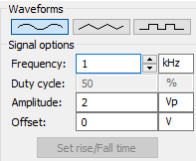
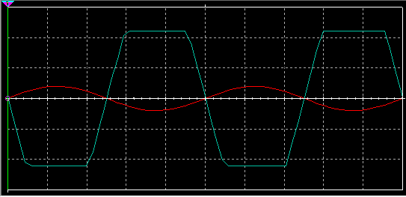


I/O Example $2$
Like Example $1$, only difference is that Amplitude of $V_{in}$ is doubled
This should double Amplitude of $V_{out}$ to 20V , but as 20V is greater than supply voltage of Op-Amp (12V), any part of the output signal which should have amplitude more than 12V will be limited to 12V.

Slide 7
Question 2
Implement an Op-Amp Circuit that produce a linear combination of two input voltages at the output.

Slide 8
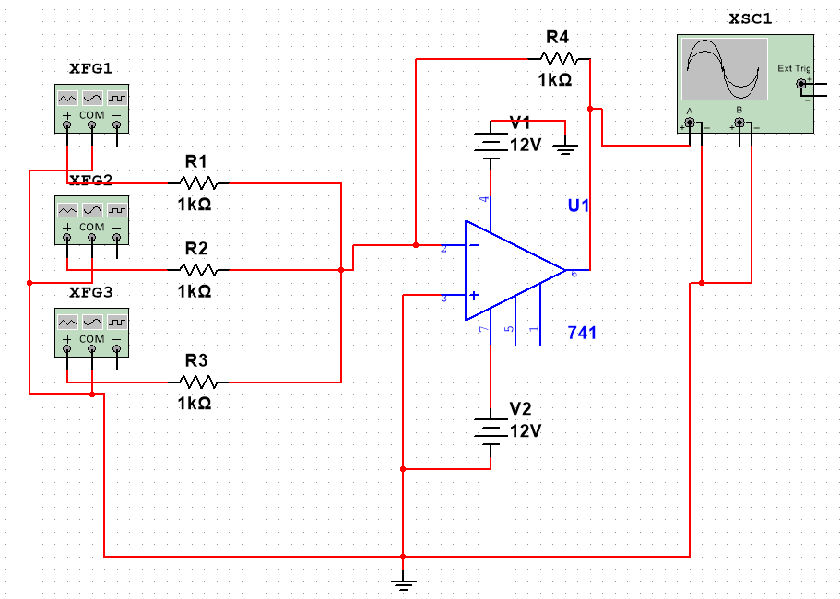
Addition Circuit

Slide 9







Circuit Analysis
$$i_{1}$$
$$i_{4}$$
As Gain is Amplifier is very Large
$V_{a}− V_{b}≈0$
$or V_{a}≈V_{b}≈0 (V_{a} Grounded)$
Using Kirchhoff's Current Law :
$\frac{0 −V_{1}}{R_{1}}+\frac{0 −V_{2}}{R_{2}}+\frac{0 −V_{3}}{R_{3}}+\frac{0 − V_{out}}{R_{4}}=0$
$or V_{out}=−R_{4}\left[\frac{V_{1}}{R_{1}}+\frac{V_{2}}{R_{2}}+\frac{V_{3}}{R_{3}}\right]$
$$V_{b}$$
$$i_{2}$$
$$V_{a}$$
$$i_{3}$$

Slide 10
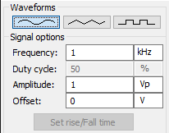
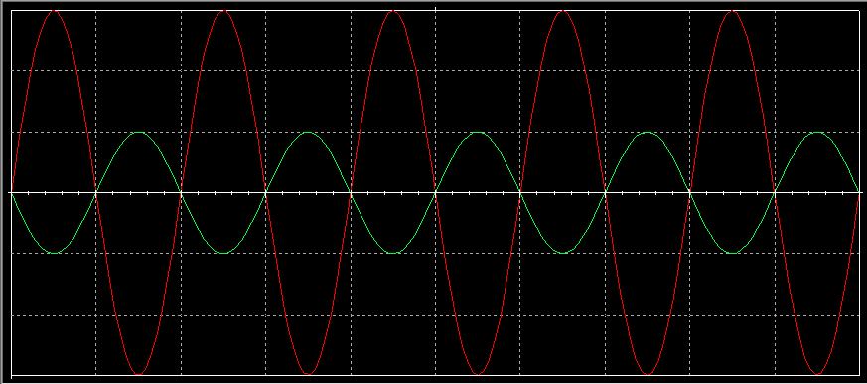


I/O Example
Here Green Plot is $V_{1}$, $V_{2}$, and $V_{3}$and the Red Plot is $V_{out}$
$R_{1}=1kΩ$, $R_{2}=1kΩ$, $R_{3}=1kΩ$, and $R_{4}=1kΩ$
$V_{out}=−R_{4}\left[\frac{V_{1}}{R_{1}}+\frac{V_{2}}{R_{2}}+\frac{V_{3}}{R_{3}}\right]$
Hence, the output will be 3 times the value of Input, and will be inverted due to –ve sign
Input of $V_{1}$, $V_{2}$, and $V_{3}$

Slide 11
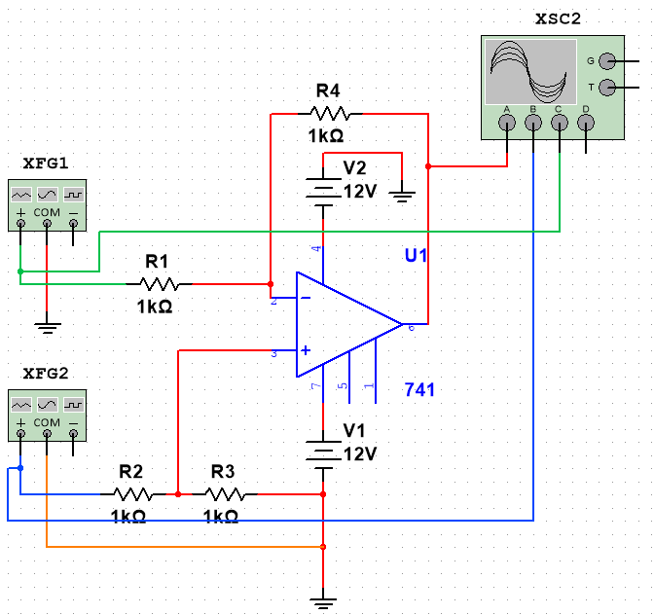
Subtraction Circuit

Slide 12







Circuit Analysis
$$i_{4}$$
As Gain is Amplifier is very Large
$V_{a}≈ V_{b}$
Kirchhoff's Current Law in $V_{a}$:
$\frac{V_{a} −V_{2}}{R_{2}}+ \frac{V_{a}−0}{R_{3}}=0$
Kirchhoff's Current Law in $V_{b}$:
$\frac{V_{b}−V_{1}}{R_{1}}+ \frac{V_{b}−V_{out}}{R_{4}}=0$
Solving these two, we get
$V_{out}=\frac{R_{4}}{R_{2}}V_{2}\frac{\left[\frac{1}{R_{1}}+\frac{1}{R_{4}}\right]}{\left[\frac{1}{R_{2}}+\frac{1}{R_{3}}\right]}−\frac{R_{4}}{R_{1}}V_{1}$
$$i_{3}$$
$$V_{b}$$
$$V_{a}$$
$$i_{1}$$
$$i_{2}$$

Slide 13
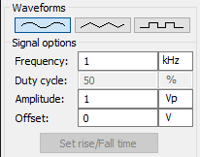
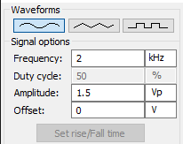
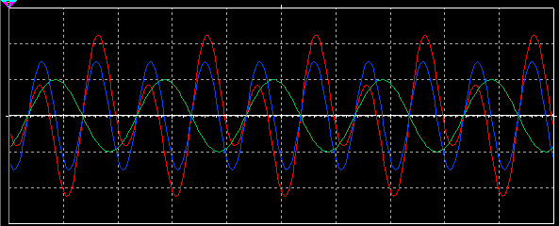



I/O Example
Here Green Plot is $V_{1}$, Blue Plot is $V_{2}$, and Red Plot is $V_{out}$
$R_{1}=1kΩ$, $R_{2}=1kΩ$, $R_{3}=1kΩ$, and $R_{4}=1kΩ$
$V_{out}=\frac{R_{4}}{R_{2}}V_{2}\frac{\left[\frac{1}{R_{1}}+\frac{1}{R_{4}}\right]}{\left[\frac{1}{R_{2}}+\frac{1}{R_{3}}\right]}−\frac{R_{4}}{R_{1}}V_{1}=V_{2}−V_{1}$
Hence, the output will be superposition of $V_{2}$ and $−V_{1}$
Input of $V_{1}$
Input of $V_{2}$

Slide 14
Question 3
Plot the magnitude vs frequency and phase vs frequency from theoretical circuit analysis and compare with the obtained frequency response. Implement the obtained formula in code to suitable. Comment on the match and departure between the theoretically obtained response and that obtained from the simulation environment.

Slide 15
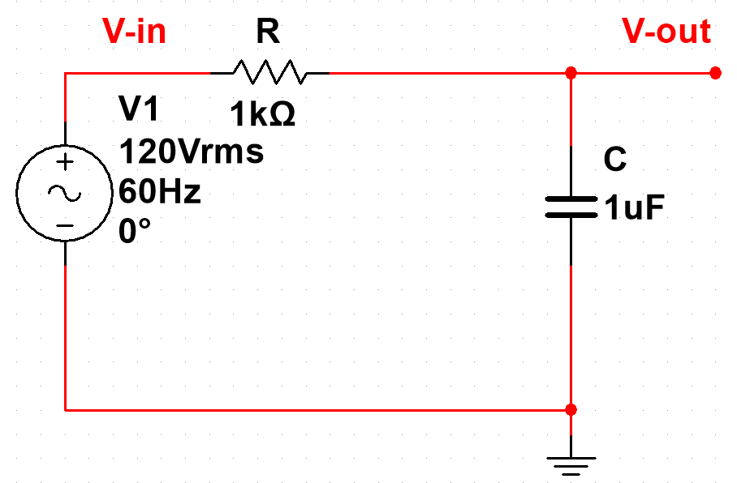
Circuit DIAGRAM

Slide 16



Circuit Analysis
$$i_{1}$$
Kirchhoff's Current Law in $V_{out}$:
$\frac{V_{out} −V_{in}}{R}+C\frac{d\left(V_{out}\right)}{dx}=0$
Using Fourier Transform:
$\frac{V_{out}\left(jω\right) −V_{in}\left(jω\right)}{R}+CjωV_{out}\left(jω\right)=0$
$V_{out}\left(jω\right)=\frac{V_{in}\left(jω\right)}{1+RCjω}$
$H\left(jω\right)=\frac{V_{out}\left(jω\right)}{V_{in}\left(jω\right)}=\frac{1}{1+RCjω}$
$\left|H\left(jω\right)\right|=\frac{1}{\sqrt{1+R^{2}C^{2}ω^{2}}}$
$∠H\left(jω\right)={−tan}^{−1}\left(RCω\right)$
$$i_{2}$$

Slide 17
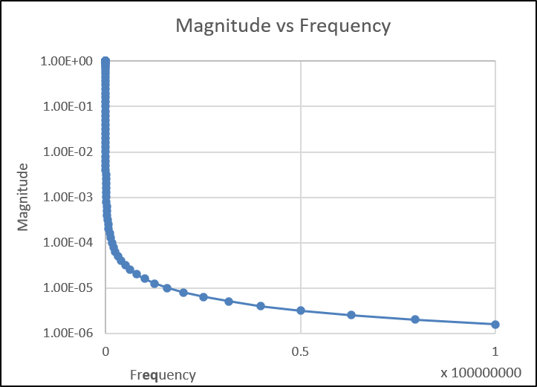
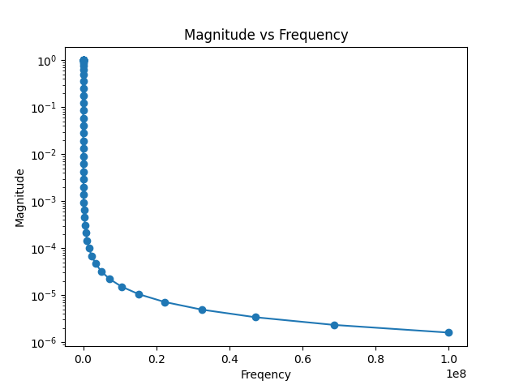
Magnitude Vs Frequency
Graph Exported By Simulator
Graph Made By Code
The Left Graph is the Graph made by Excel based on Values exported by the Simulator
The Right Graph is the Graph generated by Python Code

Slide 18
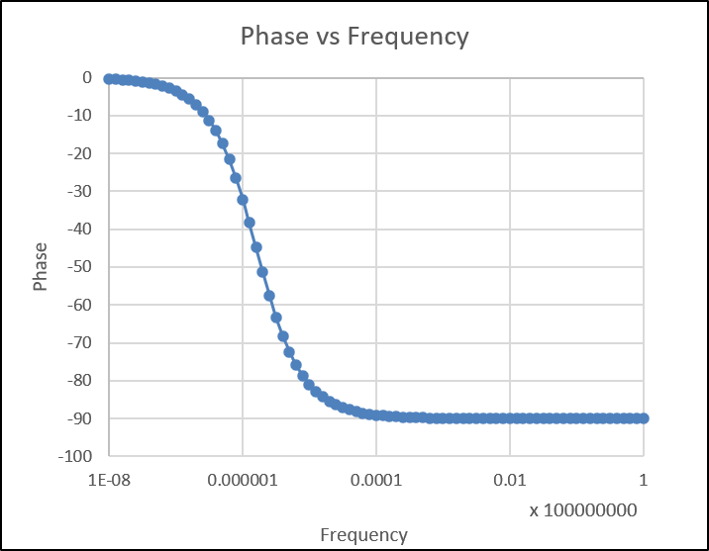
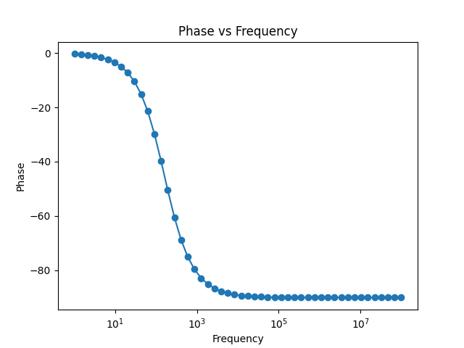
Phase Vs Frequency
Graph Exported By Simulator
Graph Made By Code
The Left Graph is the Graph made by Excel based on Values exported by the Simulator
The Right Graph is the Graph generated by Python Code

Slide 19
The END

